Slide 1
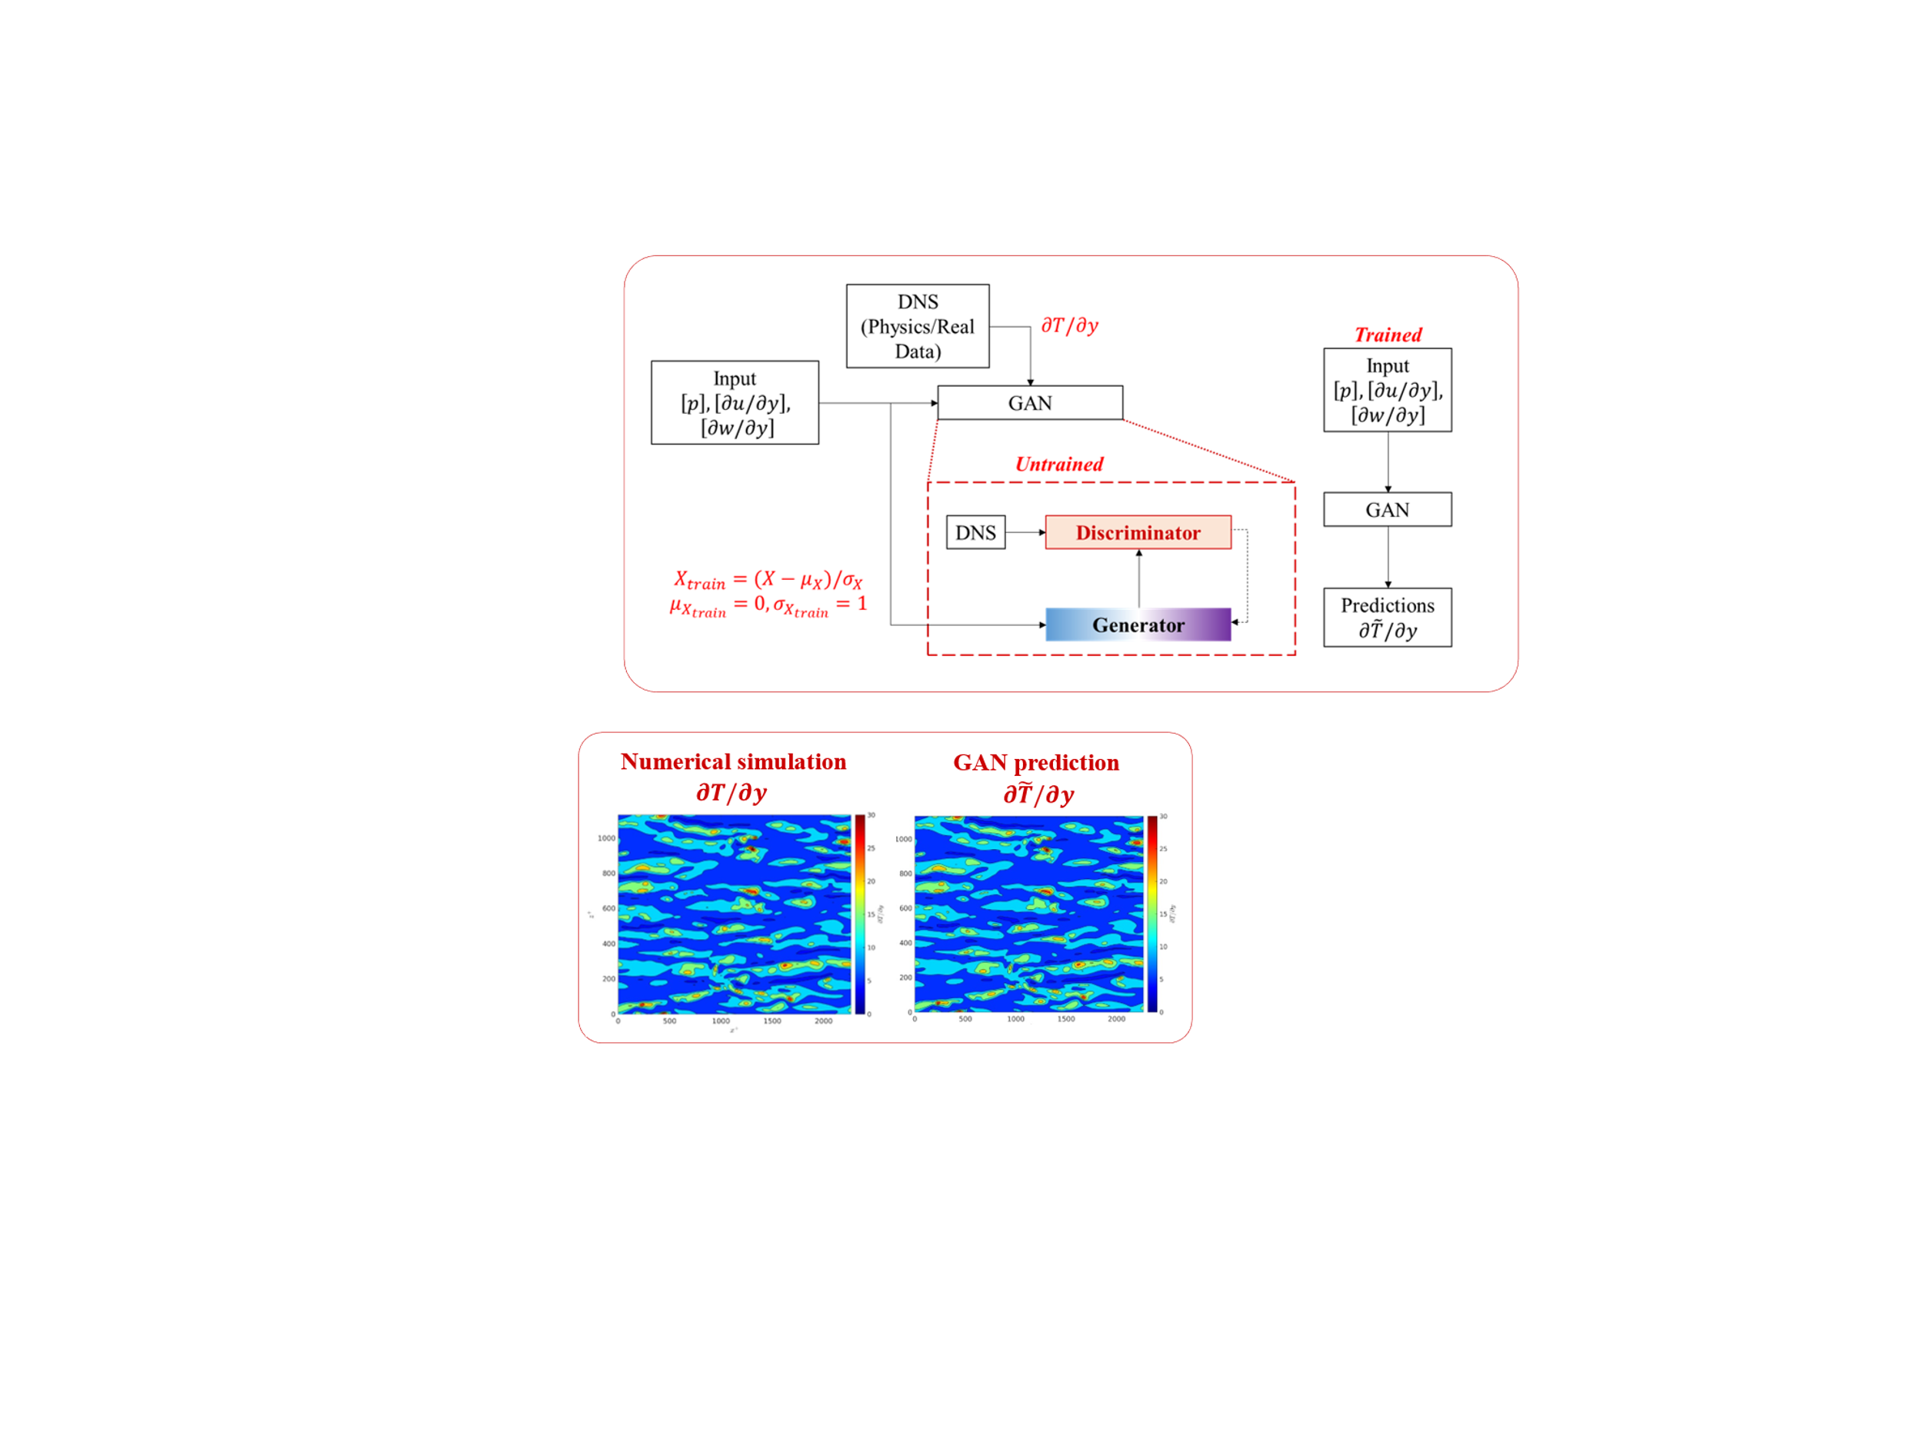
Methodology
Training results

Slide 2
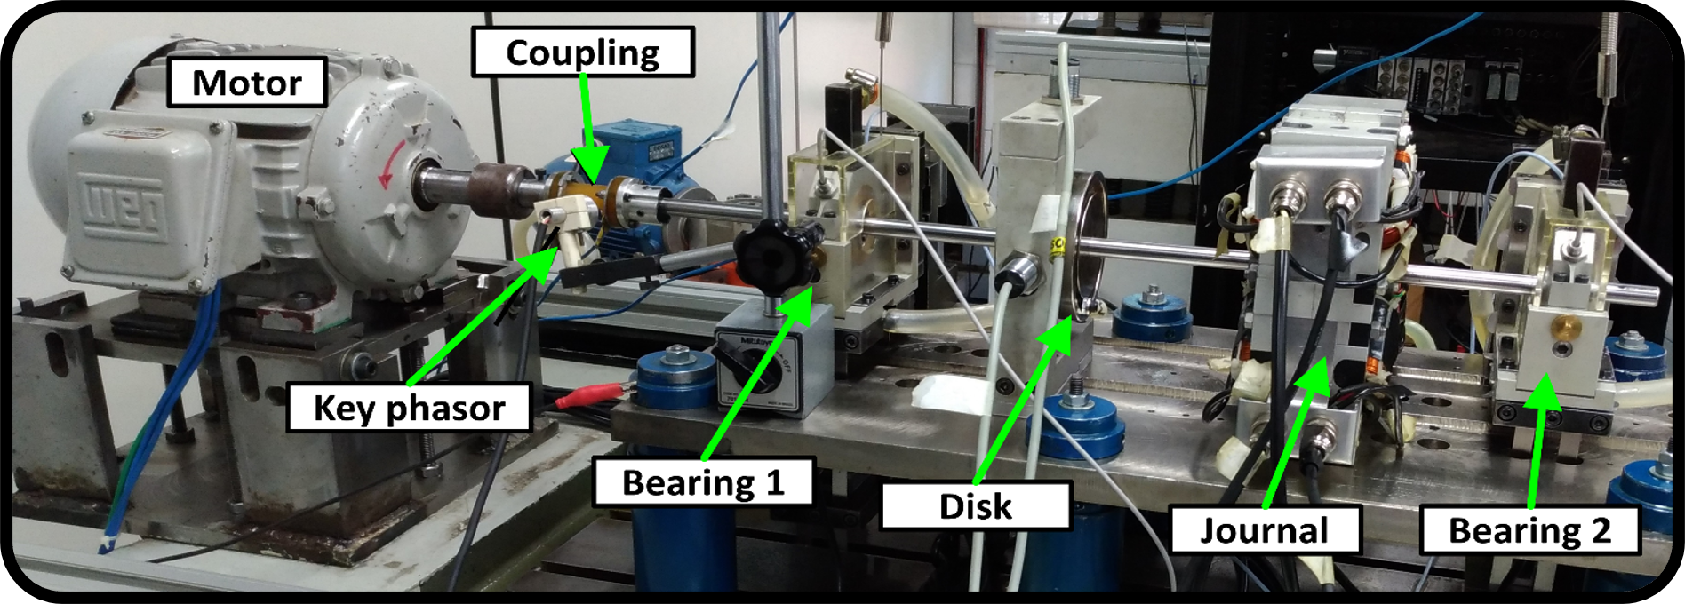
Rotary machinery experimental setup configuration
5-dimension digital twin model

Slide 3
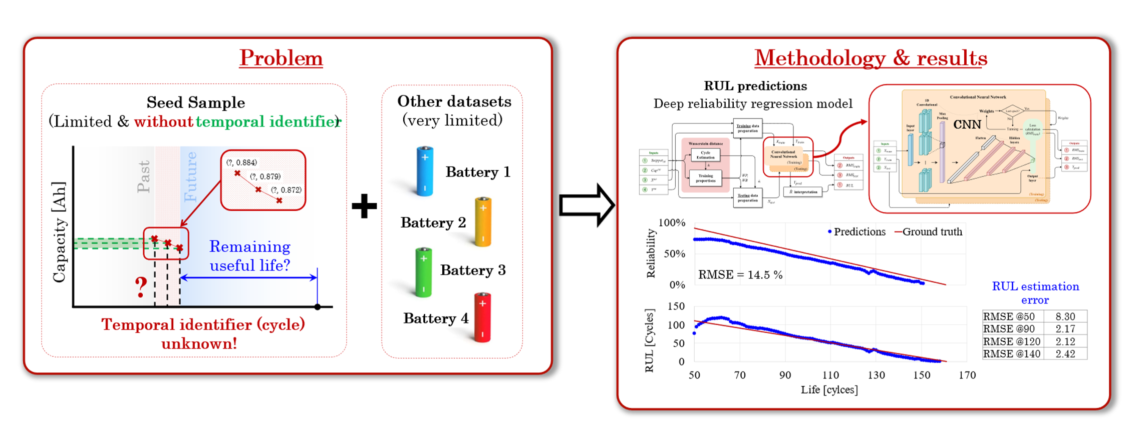
Battery remaining useful life prediction framework

Slide 4
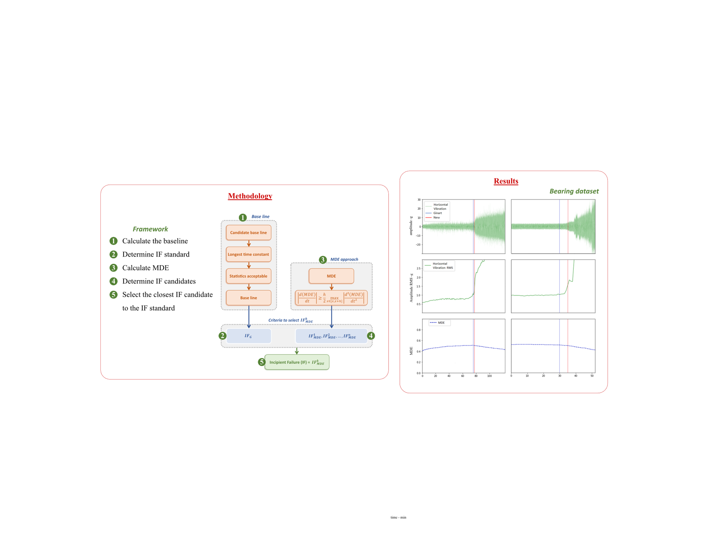
Incipient failure point prediction framework
Incipient failure point prediction results for bearing vibration dataset

Slide 5

product design &
development lab

